Slide 1
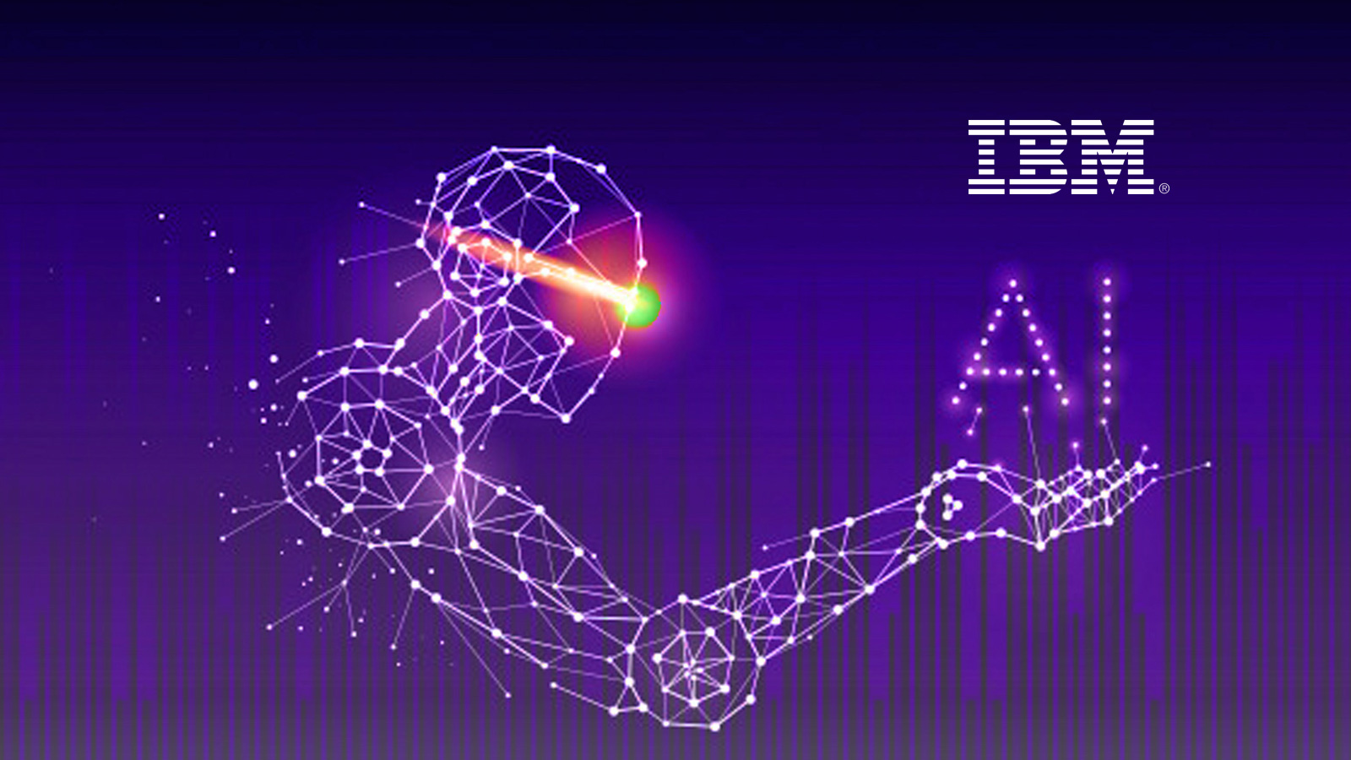
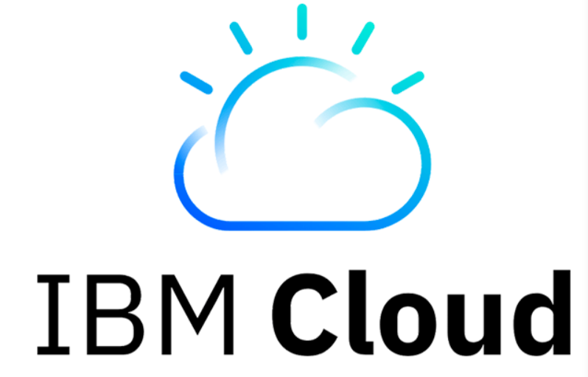
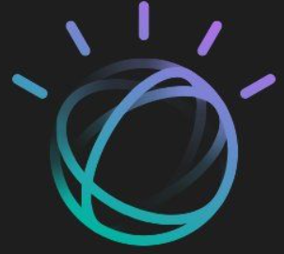
Team 3
Chaitanya
Srinija
Swaroop
Viswanth
Priyanka

Slide 2


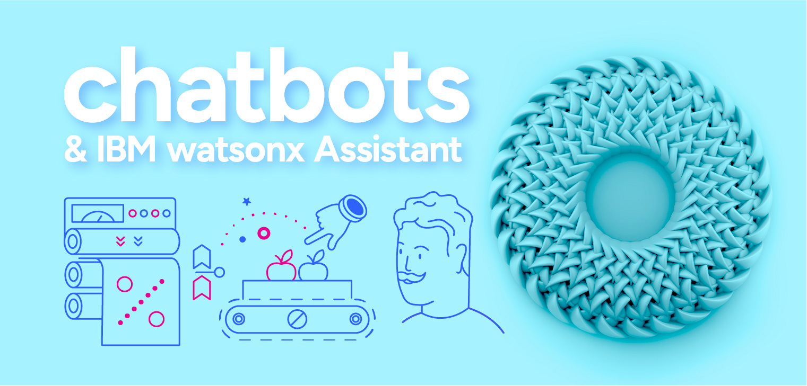
What is AI & How its used in IBM Cloud?
Artificial intelligence (AI) is technology that enables computers and machines to simulate human learning, comprehension, problem solving, decision making, creativity and autonomy.
AI Solutions in IBM cloud:
WatsonX
AI Assistants & Agents
AI Models
AI consulting
AI Infrastructure

Slide 3
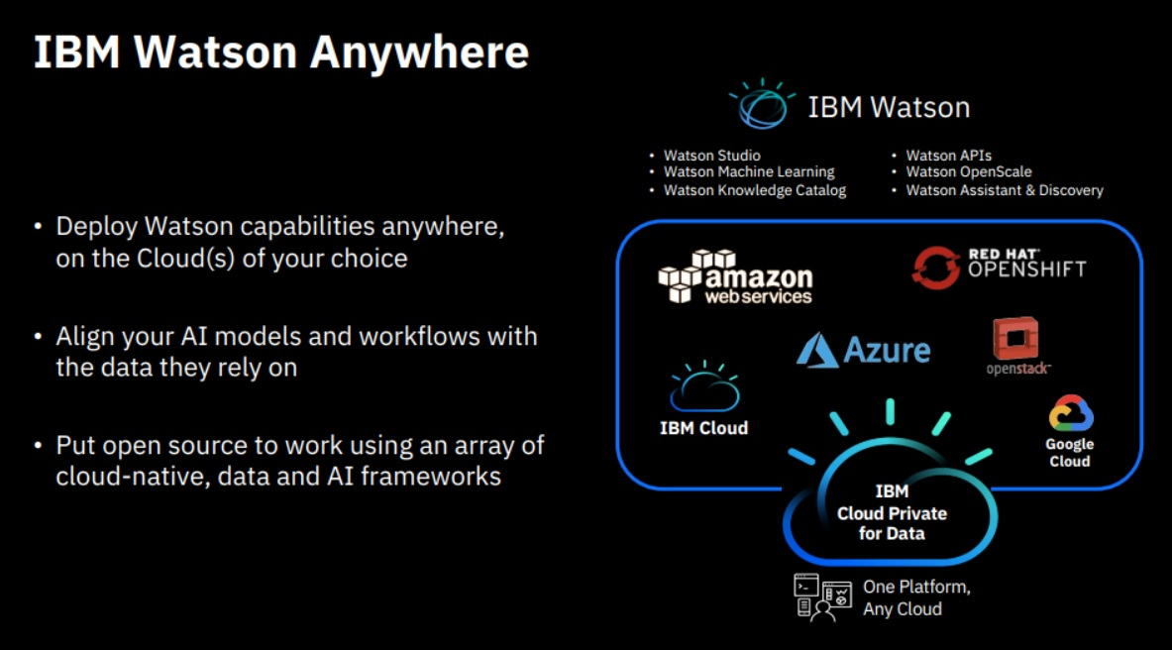
What Is IBM Watson?
Advanced Artificial Intelligence system developed by IBM (The Core of AI in IBM Cloud), designed to process and analyze large amounts of data. Watsonx AI suite includes watsonx.ai, watsonx.data, and watsonx.governance.
Services:
-Watson Assitant (Chatbots)
-Watson Discovery
-Watson Studio (Data science platform)

Slide 4
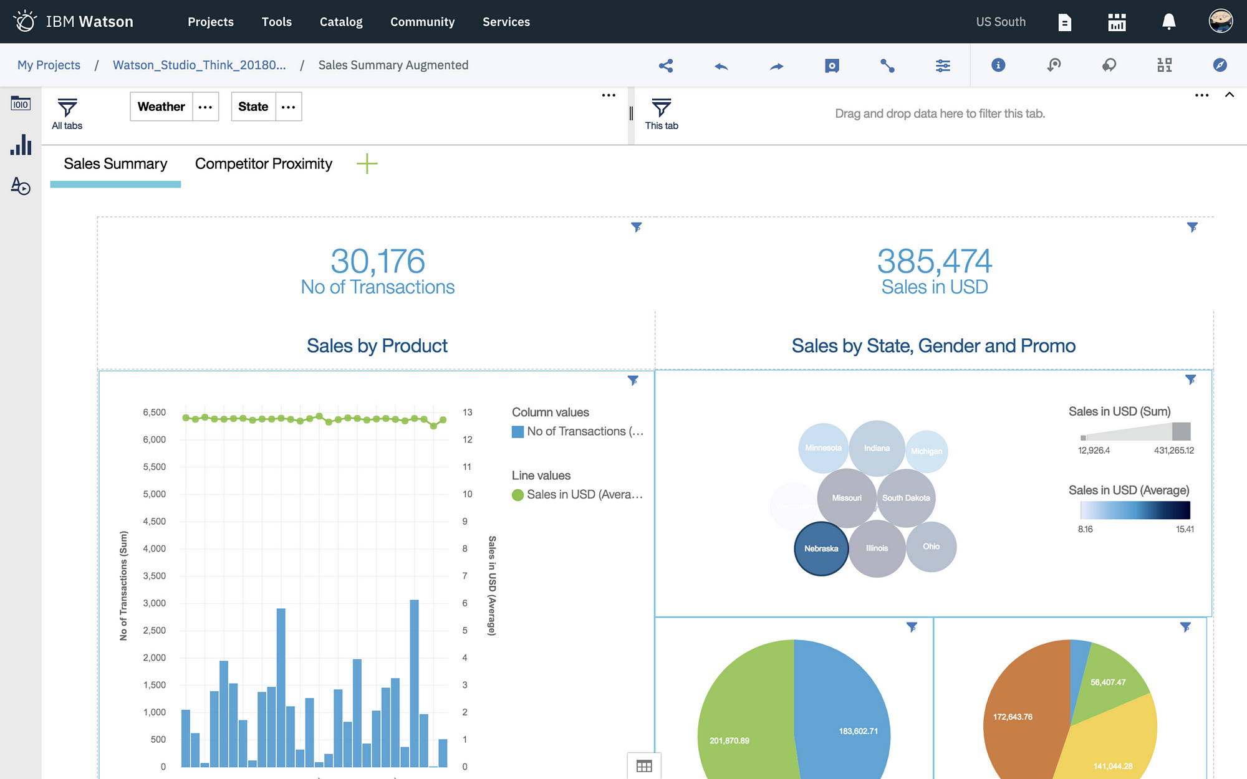
Role of AI in IBM Cloud: IBM Watson Studio
Allows to train, deploy, and manage AI models, and prepare and analyze information during a single integrated environment.

Slide 5
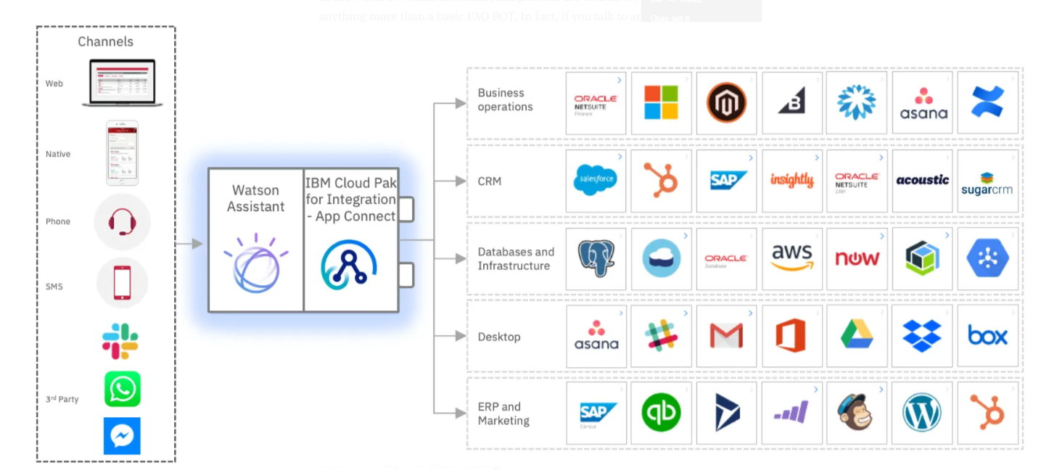
IBM Watson Assistant
Build and deploy conversational AI interfaces (chatbots, virtual agents) across various channels.

Slide 6
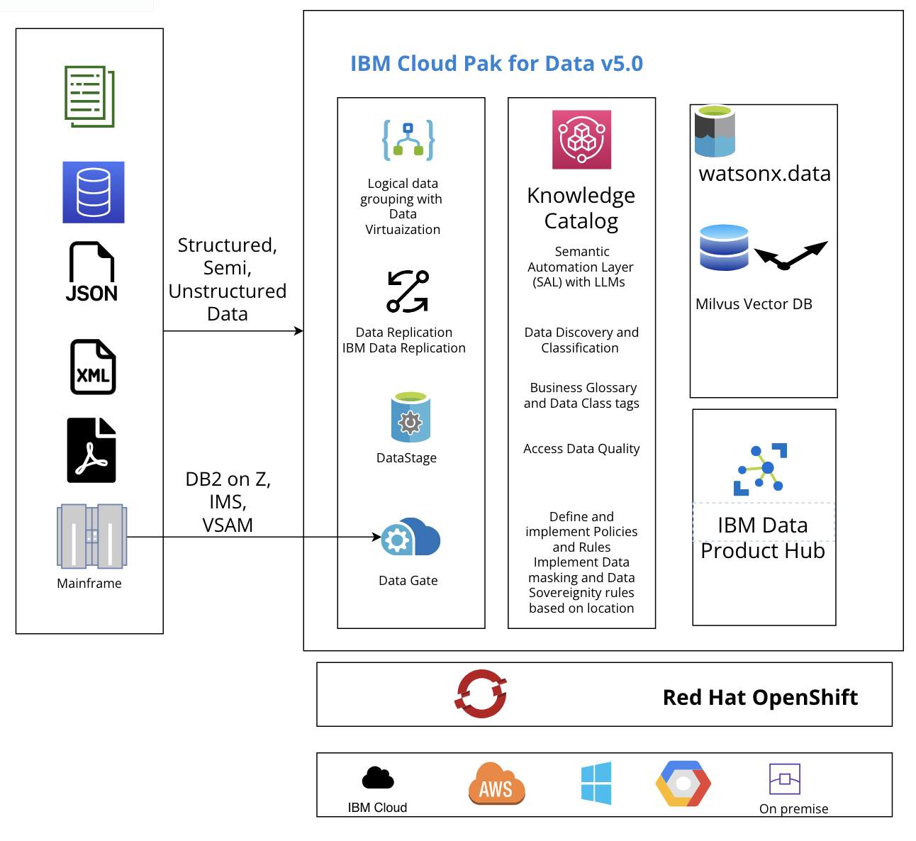
IBM Cloud Pak
It is a Data as a Service platform that
includes IBM watsonx.ai Studio.
It Integrates data for AI with
data governance.
Software platforms:
Data
Business automation
AIOps
Integration
Network Automation
Security

Slide 7
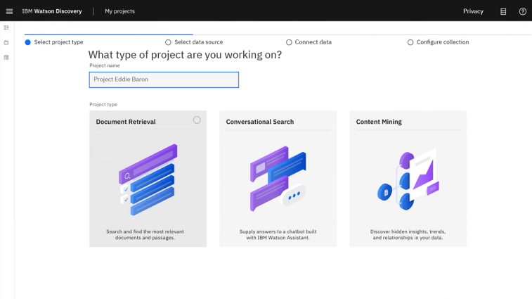
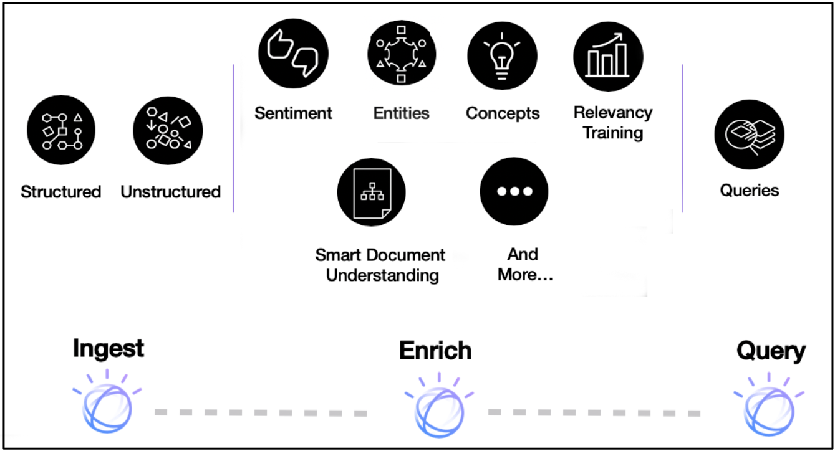
IBM Watson Discovery
AI-powered search engine and insight mining
from documents and unstructured data.

Slide 8
AI in IBM Cloud(contd ..)
IBM Granite model: enterprise-focused foundation models for tasks like text generation and code creation.
IBM Watson Machine learning.
IBM Watson Natural Language Understanding (NLU).
IBM Watson OpenScale.
IBM Watson AIOps.

Slide 9
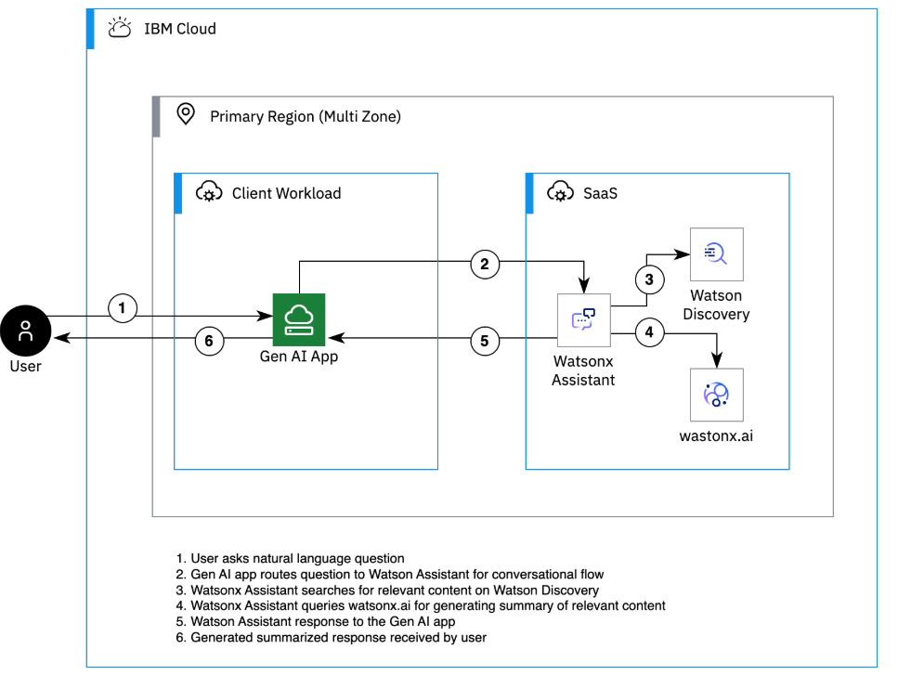
Generative AI in IBM Cloud
Creates original content (text, images, code) using models like IBM Granite.
IBM is Expanding its Accelerated Computing Platform with NVIDIA and Red Hat to Support Generative AI Growth.

Slide 10
AI use cases in IBM Cloud
Health care: Watson Discovery to analyze research papers and identify potential drug targets, medical imaging analysis.
Ecommerce: Watson Assistant chatbot on website to answer customer inquiries and process orders.
Marketing.
Sales.
Operations.
Finance: Fraud detection, risk management, customer onboarding, regulatory compliance.

Slide 11
Benefits of AI in Cloud
Handles compute-intensive AI workloads with hybrid cloud flexibility.
Integration with existing IBM and third-party systems.
Powerful Tools for the Entire AI Lifecycle.
Hybrid Cloud Capabilities with Red Hat OpenShift.
Built-in governance and compliance.

Slide 12
Case Studies
CVS Health - Watson AI for customer engagement.
Camping world(Retail) – AI powered virtual assistant enabled to increase agent efficiency 33% and modernize call centers.
Lufthansa – Watson Assistant integrated with Lufthansa’s digital platforms.
KPMG – Watson Discovery to extract and understand complex legal and financial data.
Regions Bank – Uses Watson NLU and Watson Studio on IBM Cloud.

Slide 13
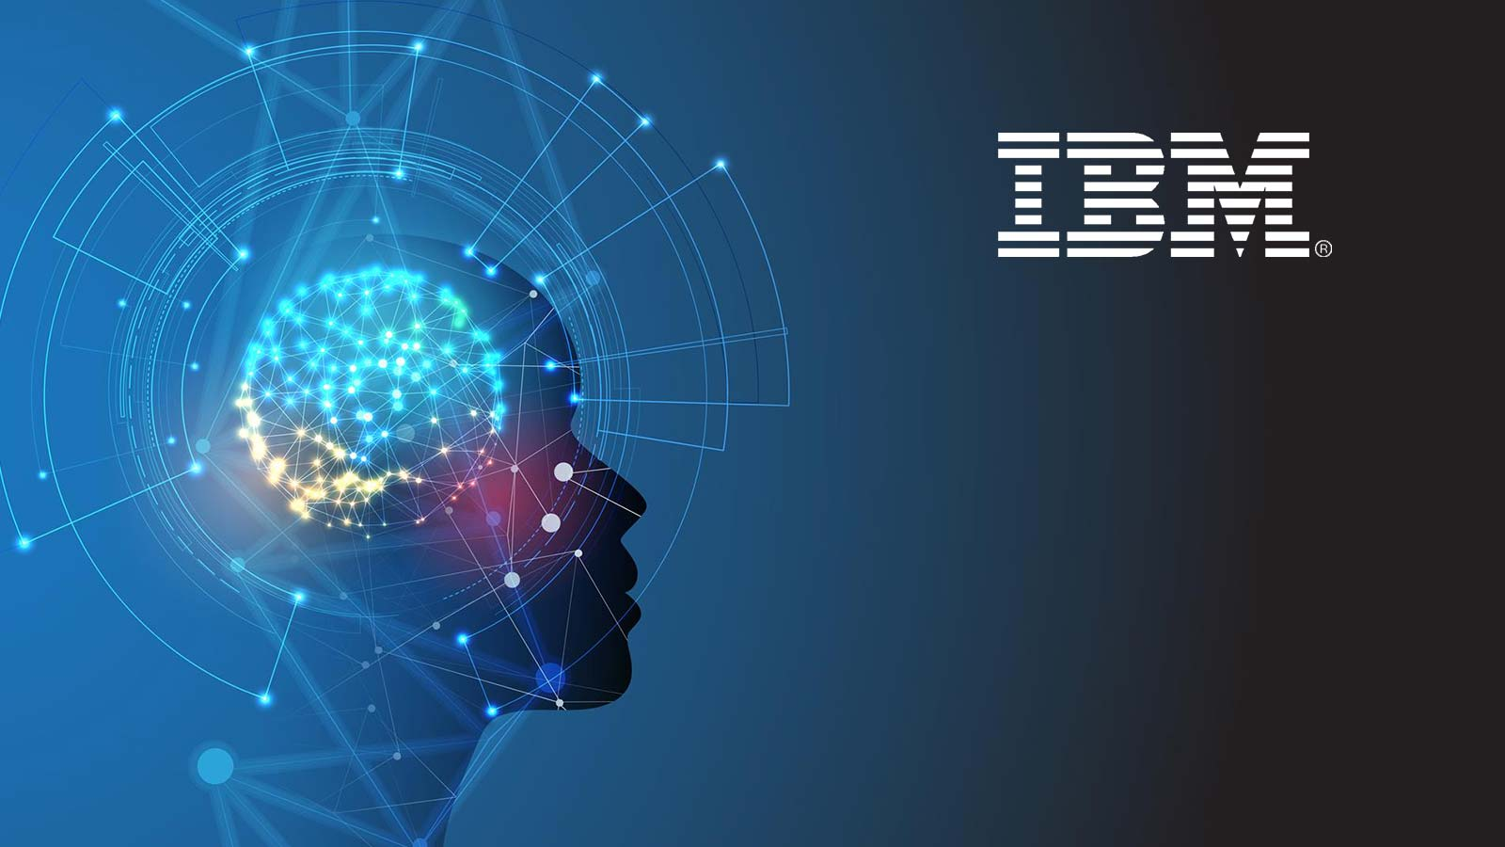
THANK YOU

